Slide 1
CyberSentinel
Sprint 2 By Team Tech Titans

Slide 2
Agenda
01
02
03
Team & Planning
User & Product Definition
Technology & Implementation
04
05
06
Tracking & Evaluation
Demonstrations & Resources
Project Documentation & Management
Team Roles & Responsibilities
Improvements Based on Professor Feedback
Project Description
Team Working Agreement
Personas
Minimum Viable Product (MVP)
Technologies
Algorithms
Metrics & Progress Tracking
Sprint 2 Retrospective
Sprint 3 Planning
Project Demo - Sprint 2
GitHub Repository Link
Live Application Demo
Sprint 1 Recap
Diagrams
Product Backlog
Sprint 2 Backlog

Slide 3
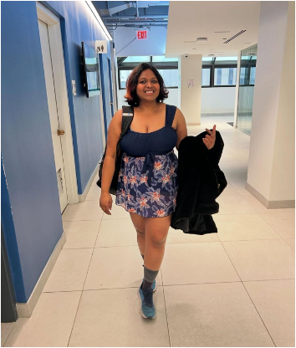


Team Members
Vaishnavi Dasari
Snehitha Bodiga
Aasritha Bhimisetty
Machine learning Engineer
Full Stack Developer
Frontend Developer

Slide 4



Team Members
Abisainath
Shoib Khan Patan
Dhanush Kolapalli
Backend Developer
Backend Developer
Machine Learning Engineer

Slide 5

Team Members
Neelkamal Rana
Full Stack Developer

Slide 6
Improvements
Improved high Accuracy in AI models
Removal of Feature Column in US.
Adding API Slide
Test Case ID
Improved Team Velocity
Key Features delivered successfully
Backend Integration was smooth
Improved Cross-functional Collaboration

Slide 7
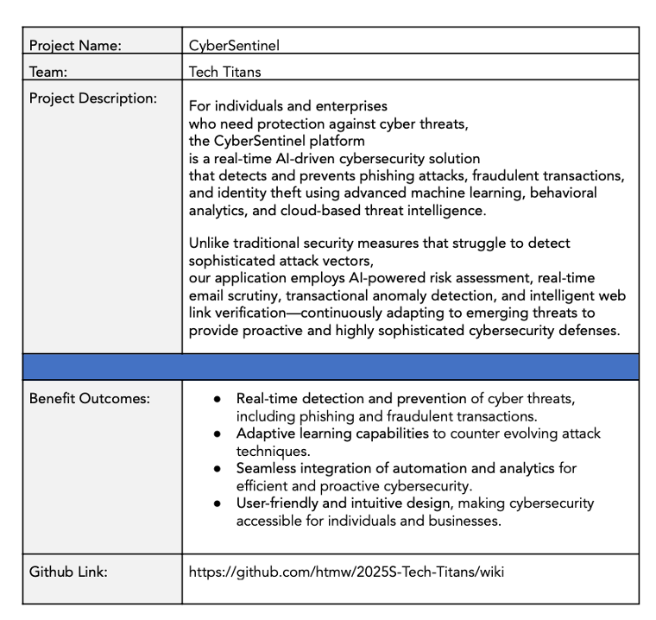


Project Description

Slide 8
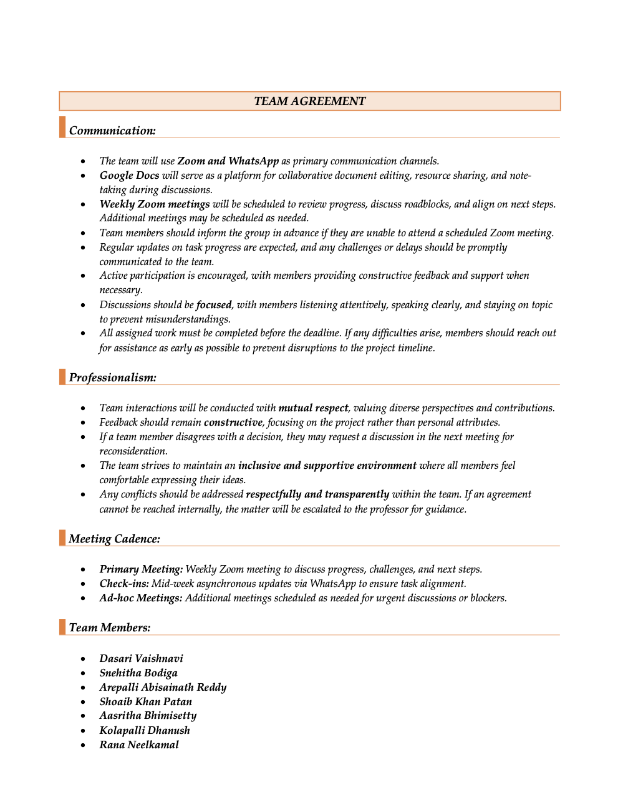
Team Agreement

Slide 9
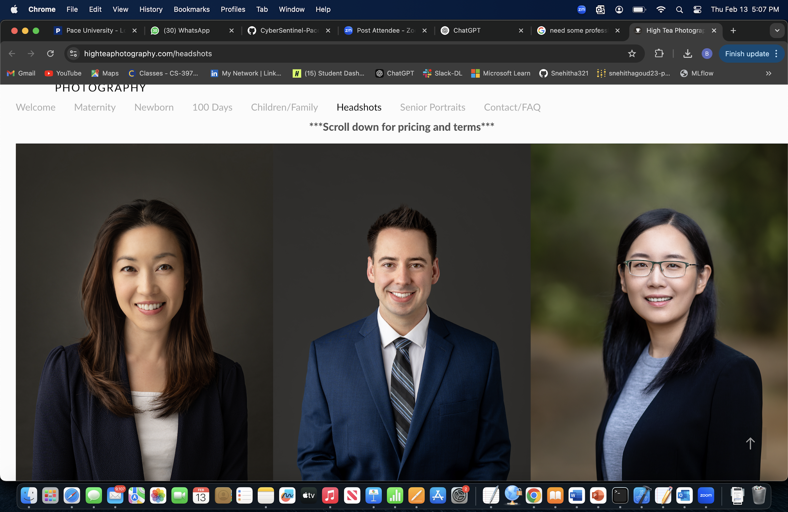
Persona
Alex works at a mid-sized tech company and is well-versed in various technologies. Spends considerable time online, both professionally and personally. Aware of cybersecurity threats but seeks advanced tools to enhance personal security.
Goals:
Protect personal and professional data from phishing and other cyber threats.
Stay informed about the latest cybersecurity practices.
Utilize AI-driven solutions for proactive threat detection.
Challenges:
Balancing convenience with robust security measures.
Identifying trustworthy cybersecurity tools amidst numerous options.
Name: Alex Johnson
Age: 32
Occupation: Software Developer

Slide 10
Persona
Manages a team remotely for a marketing firm. Juggles professional responsibilities with parenting two teenagers. Uses multiple devices for work and personal tasks.
Goals:
- Ensure the security of sensitive work-related information.
- Protect family members, especially children, from online threats.
- Maintain a secure digital environment across all devices.
Challenges:
- Limited time to manage and monitor cybersecurity measures.
- Keeping up with evolving cyber threats and ensuring family compliance with best practices.
Name: Maria Thompson
Age: 40
Occupation: Project Manager

Slide 11
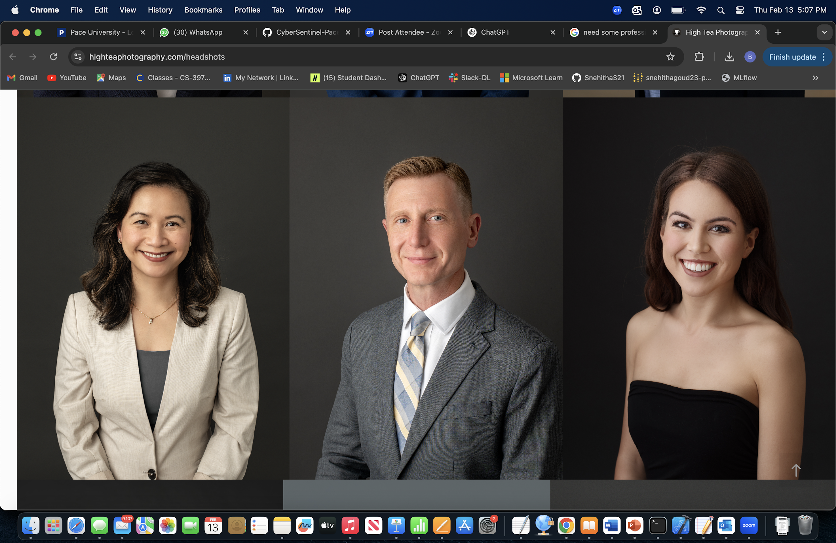
Persona
Runs an online storefront in addition to the physical store. Handles customer data, including payment information. Has basic knowledge of cybersecurity but lacks specialized expertise.
Goals:
- Protect customer data to maintain trust and comply with regulations.
- Prevent financial losses due to cyber attacks.
- Implement cost-effective security solutions without extensive technical knowledge.
Challenges:
- Limited budget for cybersecurity investments.
- Difficulty in assessing which security measures are necessary and effective.
Name: David Kim
Age: 45
Occupation: Owner of a local retail store

Slide 12
Minimum Viable Product (MVP)
Phishing Email Detection Uses NLP models trained on cybersecurity datasets to classify emails as safe or phishing. Helps prevent social engineering attacks by identifying malicious content in real-time.
Fraudulent Transaction Detection Applies anomaly detection techniques to flag suspicious financial transactions. This component supports real-time monitoring for enterprise-level financial systems.
URL Classification Analyzes lexical features of URLs to determine if a web link is malicious or safe. Provides an added layer of protection against phishing websites and drive-by downloads.
User Dashboard A centralized interface that displays alerts, threat levels, and risk analysis in real-time. It allows users to monitor cybersecurity threats and take quick preventive action.

Slide 13




Technologies – Development Stack
Frontend: React.js (for simple and interactive UI)
Backend: Flask (lightweight Python-based API)
Database: PostgreSQL (to store detected threat data)
Hosting: AWS (for cloud deployment and scalability)

Slide 14



Technologies - AI & Cybersecurity Tools
Machine Learning: Scikit-learn, PyTorch (for phishing and fraud detection)
Security: OAuth 2.0 (for authentication), OpenCV (for URL analysis)
Threat Detection Models: NLP-based phishing email classification, anomaly detection for fraudulent transactions, and URL classification algorithms

Slide 15
Algorithms
Phishing Email Detection:
Algorithm: BERT (Bidirectional Encoder Representations from Transformers)
Utilizes a pre-trained deep learning model for text classification.
Captures contextual meaning of words, improving phishing email detection.
Fine-tuned on phishing email datasets for high accuracy.
Fraudulent Transaction Detection:
Algorithm: Autoencoder with Isolation Forest
Autoencoder reduces dimensionality and extracts essential transaction features.
Isolation Forest detects anomalies based on learned representations.
Efficient for unsupervised learning, detecting fraud without requiring labeled data.
URL Classification:
Algorithm: CNN + LSTM (Convolutional Neural Network + Long Short-Term Memory)
CNN extracts spatial features from URL structure.
LSTM captures sequential patterns, improving detection of phishing URLs.
Hybrid deep learning model for better performance over traditional classifiers.

Slide 16
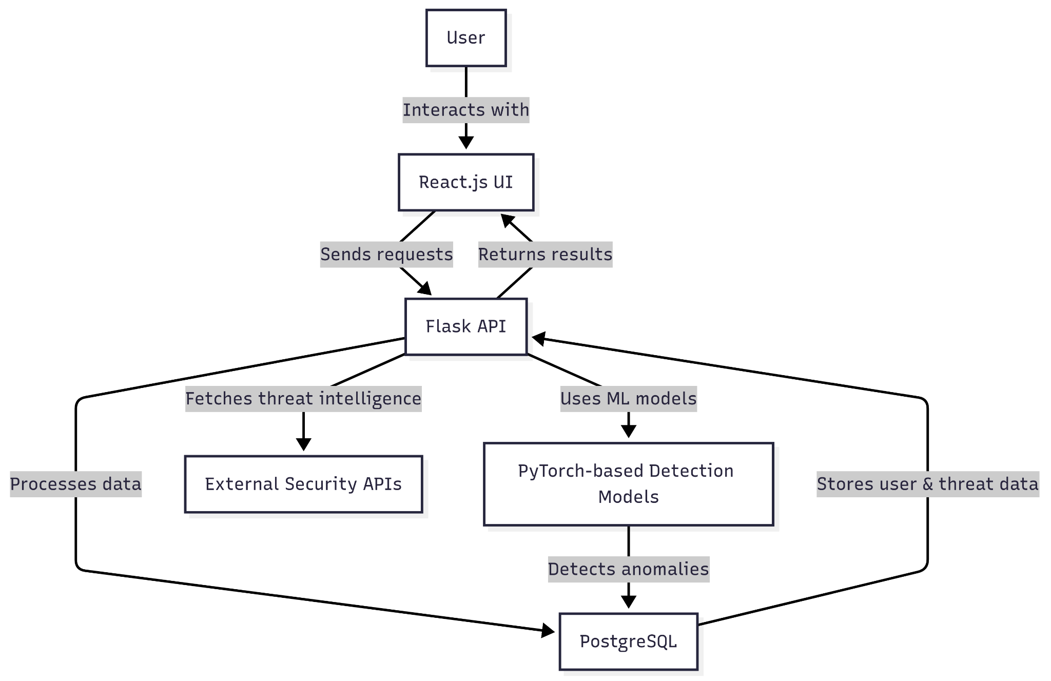
Architecture Diagram

Slide 17
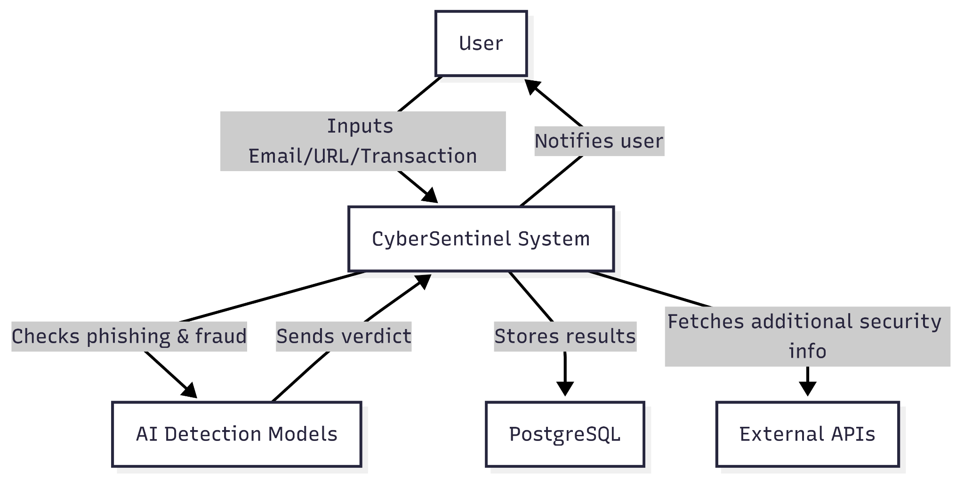
Context Diagram

Slide 18
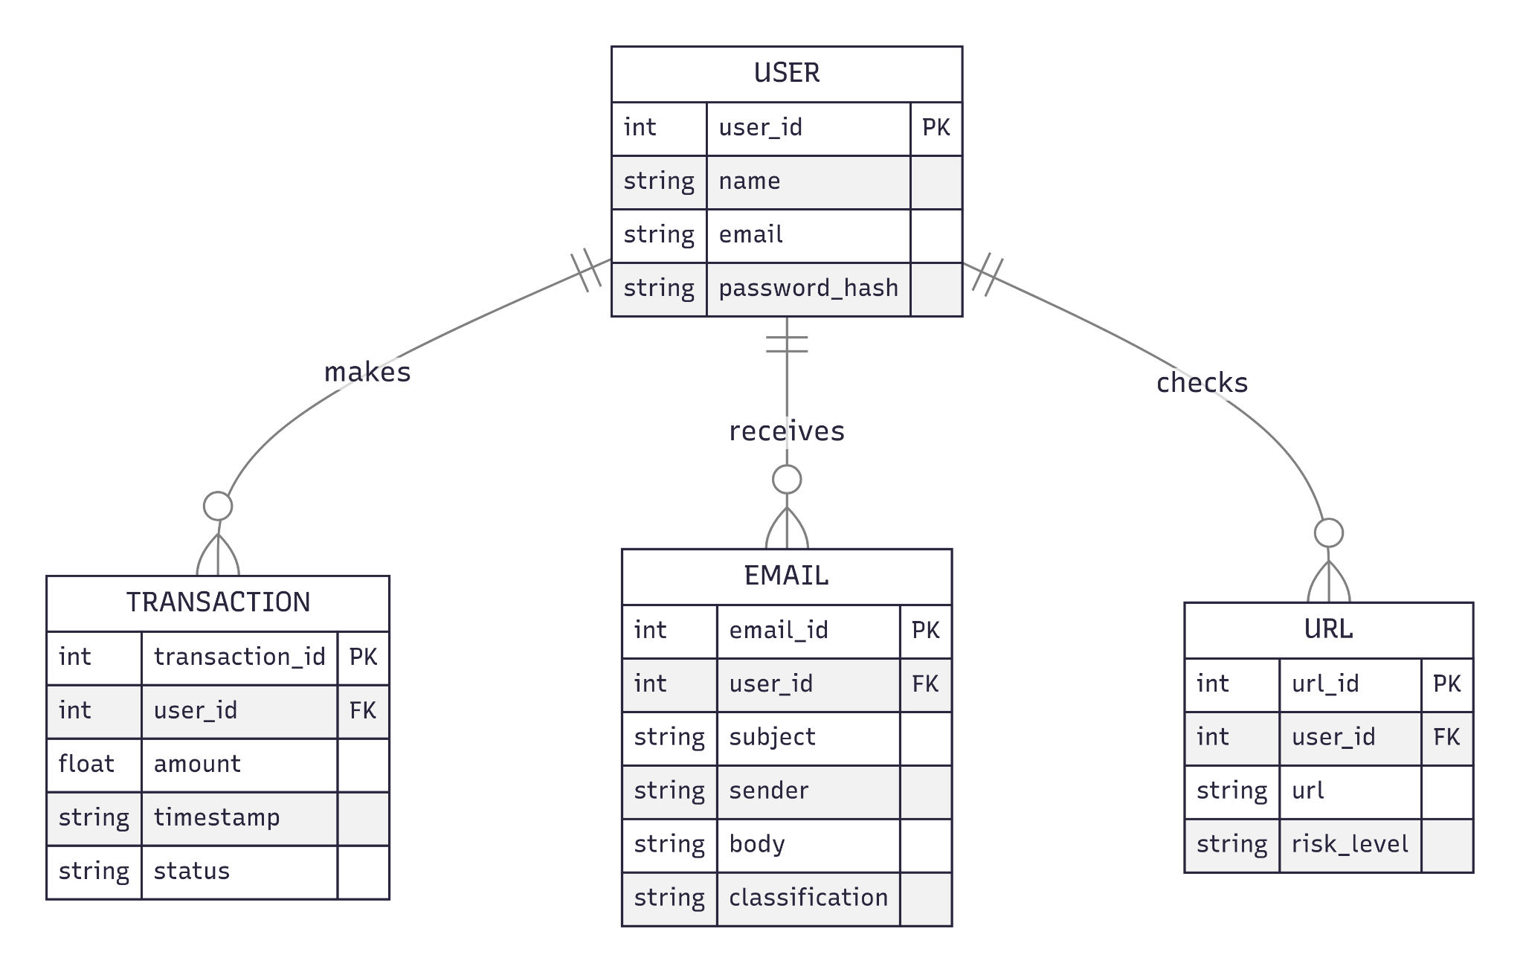
ER Diagram

Slide 19
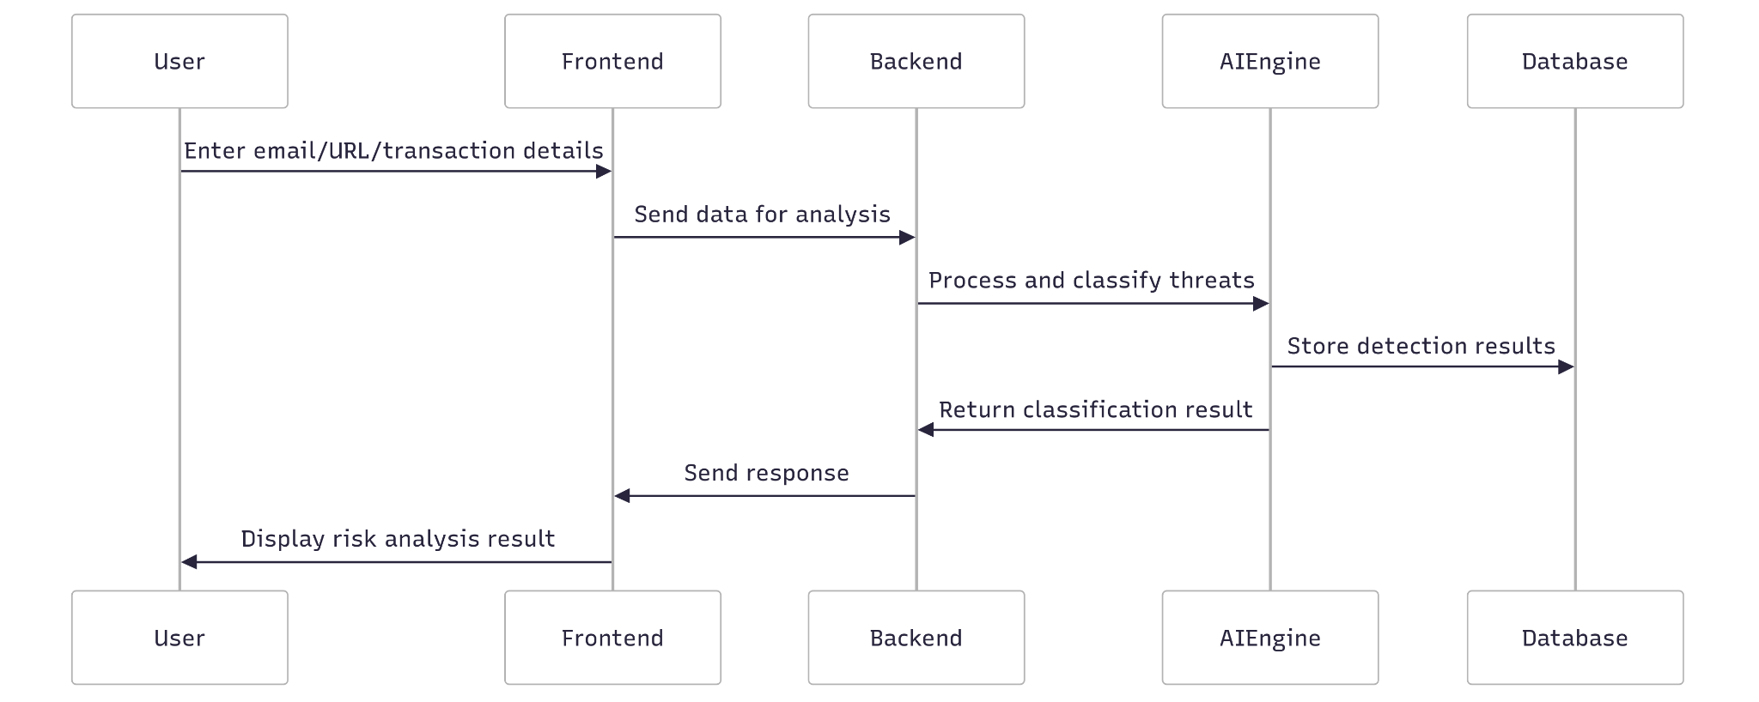
Sequence Diagram

Slide 20
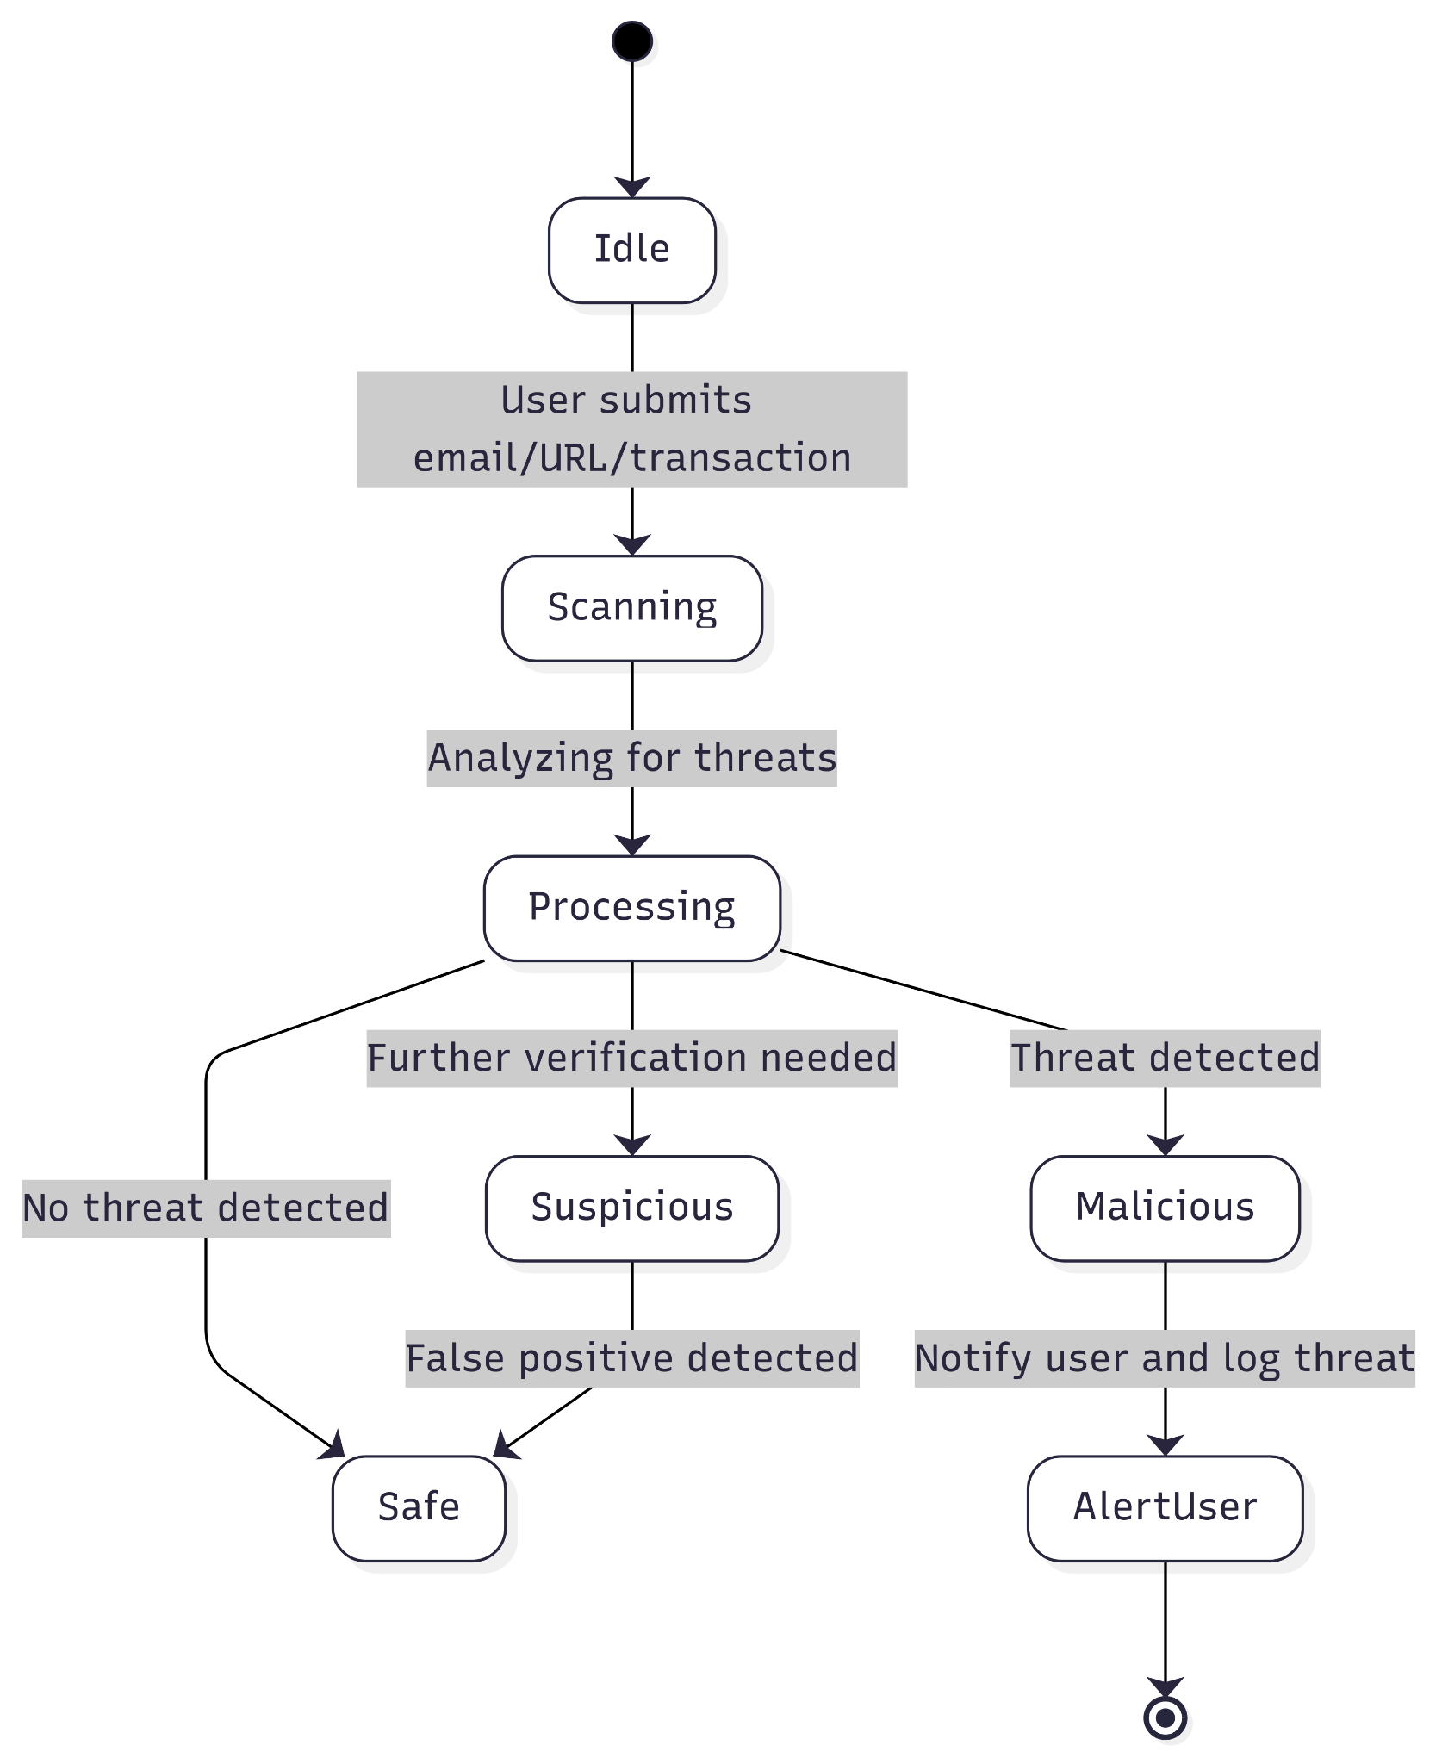
Flow Diagram

Slide 21
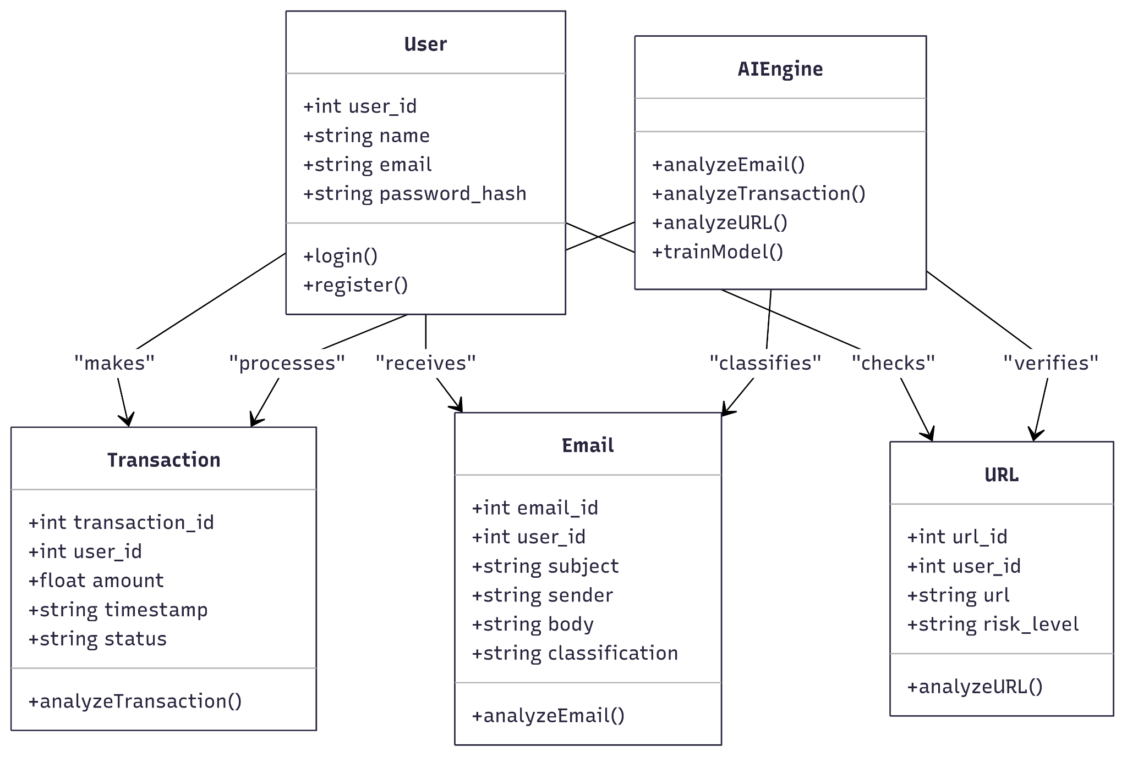
Class Diagram

Slide 22
Product Backlog - User Stories
ID | User Story | Acceptance Criteria | Sprint | Story Points
US_01 | As someone monitoring threats, I want a dashboard to view phishing email history so that I can track past threats. | Dashboard displays list of phishing emails with filtering options. | Sprint 1 | 5
US_02 | As an email recipient, I want to filter emails based on risk level so that I can quickly identify dangerous emails. | System allows filtering by safe, suspicious, and phishing categories. | Sprint 1 | 3
US_03 | As a security admin, I want to view statistics on detected threats so that I can analyze system performance. | Dashboard provides statistics on phishing, fraud, and malicious URLs. | Sprint 1 | 8
US_04 | As a platform administrator, I want to manage user roles and permissions so that I can control access levels. | System supports different access levels for users and admins. | Sprint 1 | 8
US_05 | As an individual reviewing suspicious emails, I want to upload an email for phishing detection so that I can know if it's safe. | System classifies email as safe, suspicious, or phishing with an alert. | Sprint 2 | 8

Slide 23
Product Backlog - User Stories
ID | User Story | Acceptance Criteria | Sprint | Story Points
US_06 | As a finance manager, I want to upload transaction data so that I can detect fraudulent activities. | System flags transaction as normal or suspicious with a confidence score. | Sprint 2 | 13
US_07 | As someone browsing the web, I want to check if a URL is malicious so that I can avoid phishing sites. | System checks URL structure and domain reputation, classifying it as safe, suspicious, or malicious. | Sprint 2 | 5
US_08 | As a cautious email reader, I want to verify if a sender email is trustworthy so that I can decide whether to engage with the sender. | System checks sender reputation and displays a trust score. | Sprint 2 | 8
US_09 | As a system user, I want to receive real-time alerts for detected threats so that I can take immediate action. | User receives notifications via email or app for detected threats. | Sprint 3 | 8
US_10 | As a user of the detection system, I want an option to report a false positive classification so that I can help improve detection accuracy. | Users can flag an incorrect detection for review. | Sprint 3 | 3

Slide 24
Product Backlog - Technical Stories
ID | Technical Story | Acceptance Criteria | Sprint | Story Points
TS_01 | Create a dashboard for threat statistics so that admins can monitor system performance. | Dashboard displays data on detected threats. | Sprint 1 | 8
TS_02 | Design a user role management system so that access levels can be controlled efficiently. | Admins can assign permissions to different user roles. | Sprint 1 | 8
TS_03 | Implement OAuth authentication for secure user access so that users can log in securely. | User authentication is secure, and access tokens work correctly. | Sprint 1 | 5
TS_04 | Set up AWS for cloud deployment so that the system can be scalable and accessible. | Backend deployed and accessible via API. | Sprint 1 | 5
TS_05 | Integrate BERT model for phishing email detection so that emails can be classified accurately. | Model achieves at least 90% accuracy on test data. | Sprint 2 | 8

Slide 25
Product Backlog - Technical Stories
ID | Technical Story | Acceptance Criteria | Sprint | Story Points
TS_06 | Implement Autoencoder + Isolation Forest for fraud detection so that anomalies in transactions can be detected. | Model correctly classifies anomalies in dataset. | Sprint 2 | 13
TS_07 | Deploy CNN + LSTM model for URL detection so that phishing websites can be identified. | Model classifies URLs with at least 85% accuracy. | Sprint 2 | 8
TS_08 | Implement email sender verification model so that sender reputation can be assessed. | System provides a sender trust score based on reputation. | Sprint 2 | 5
TS_09 | Develop a notification system for real-time alerts so that users are informed of potential threats. | Users receive accurate notifications for detected threats. | Sprint 3 | 8
TS_10 | Develop a feedback mechanism for false positive reports so that the system can improve over time. | Users can flag and submit incorrect classifications for review. | Sprint 3 | 3

Slide 26
Sprint 2 Backlog
ID | User Story / Task | Acceptance Criteria | Story Points
US_04 | As an admin, I want to manage user roles and permissions so that I can control access levels. | System supports different access levels for users and admins. | 8
TS_03 | Implement OAuth authentication for secure user access so that users can log in securely. | User authentication is secure, and access tokens work correctly. | 5
US_05 | As an individual reviewing suspicious emails, I want to upload an email for phishing detection so that I can know if it's safe. | System classifies email as safe, suspicious, or phishing with an alert. | 8
US_06 | As a finance manager, I want to upload transaction data so that I can detect fraudulent activities. | System flags transaction as normal or suspicious with a confidence score. | 13
US_07 | As someone browsing the web, I want to check if a URL is malicious so that I can avoid phishing sites. | System checks URL structure and domain reputation, classifying it as safe, suspicious, or malicious. | 5

Slide 27
Sprint 2 Backlog
ID | User Story / Task | Acceptance Criteria | Story Points
US_08 | As a cautious email reader, I want to verify if a sender email is trustworthy so that I can decide whether to engage with the sender. | System checks sender reputation and displays a trust score. | 8
TS_05 | Integrate BERT model for phishing email detection so that emails can be classified accurately. | Model achieves at least 90% accuracy on test data. | 8
TS_06 | Implement Autoencoder + Isolation Forest for fraud detection so that anomalies in transactions can be detected. | Model correctly classifies anomalies in dataset. | 13
TS_07 | Deploy CNN + LSTM model for URL detection so that phishing websites can be identified. | Model classifies URLs with at least 85% accuracy. | 8

Slide 28
Test Cases Sprint 2
Test Case ID | Story ID | Test Case | Expected Outcome | Actual Outcome | Pass/Fail
TC_01 | US_04 | Verify that admin can assign different roles to users (admin/user). | System successfully saves and applies roles, restricting access based on role type. | Roles not applied correctly; access not restricted. | Fail
TC_02 | US_04 | Attempt restricted action as a non-admin user. | Access is denied and appropriate error message is shown. | Action allowed for non-admin user. | Fail
TC_03 | TS_03 | Test OAuth login flow with valid credentials. | User logs in successfully and receives a valid access token. | Login unsuccessful; token not generated. | Fail
TC_04 | TS_03 | Test OAuth login with invalid credentials. | Login fails and user is prompted with an error message. | No proper error message shown; system crashes. | Fail
TC_05 | US_05 | Upload a phishing email sample for detection. | System classifies email as "phishing" and shows alert. | Email classified as phishing and alert displayed. | Pass

Slide 29
Test Cases Sprint 2
Test Case ID | Story ID | Test Case | Expected Outcome | Actual Outcome | Pass/Fail
TC_06 | US_05 | Upload a safe email sample. | System classifies email as "safe" without alerts. | Email correctly classified as safe. | Pass
TC_07 | TS_05 | Evaluate BERT model accuracy using test dataset. | Model reaches at least 90% classification accuracy. | Achieved 91.3% accuracy on test data. | Pass
TC_08 | US_06 | Upload a transaction with known fraud pattern. | System flags it as suspicious with high confidence score. | Flagged as suspicious with 92% confidence. | Pass
TC_09 | US_06 | Upload normal transaction data. | System classifies it as normal with a confidence score. | Classified as normal with 96% confidence. | Pass
TC_10 | TS_06 | Evaluate fraud detection model on test set. | Anomalies are correctly flagged in the dataset. | Anomalies detected with high accuracy. | Pass

Slide 30
Test Cases Sprint 2
Test Case ID | Story ID | Test Case | Expected Outcome | Actual Outcome | Pass/Fail
TC_11 | US_07 | Enter a known malicious URL. | System classifies it as "malicious". | URL detected as malicious. | Pass
TC_12 | US_07 | Enter a safe URL. | System classifies it as "safe". | URL classified as safe. | Pass
TC_13 | TS_07 | Run URL model on benchmark dataset. | Model classifies with minimum 85% accuracy. | Model achieved 87.5% accuracy. | Pass
TC_14 | US_08 | Submit sender email for reputation check. | System shows a trust score and message. | Sender trust score displayed correctly. | Pass

Slide 31
Sprint 2 Stories Completed
ID | User Story / Task | Story Points
US_05 | As a user, I want to upload an email for phishing detection so that I can know if it's safe. | 8
US_06 | As a user, I want to upload transaction data so that I can detect fraudulent activities. | 13
US_07 | As a user, I want to check if a URL is malicious so that I can avoid phishing sites. | 5
US_08 | As a user, I want to verify if a sender email is trustworthy so that I can decide whether to engage with the sender. | 8
TS_05 | Integrate BERT model for phishing email detection so that emails can be classified accurately. | 8
TS_06 | Implement Autoencoder + Isolation Forest for fraud detection so that anomalies in transactions can be detected. | 13
TS_07 | Deploy CNN + LSTM model for URL detection so that phishing websites can be identified. | 8

Slide 32
Sprint 2 Stories Not Completed
ID | User Story / Task | Story Points
US_04 | As an admin, I want to manage user roles and permissions so that I can control access levels. | 8
TS_03 | Implement OAuth authentication for secure user access so that users can log in securely. | 5
Total Not Completed Story Points: 13

Slide 33
Team Velocity
Total Story Points Completed: 63

Slide 34
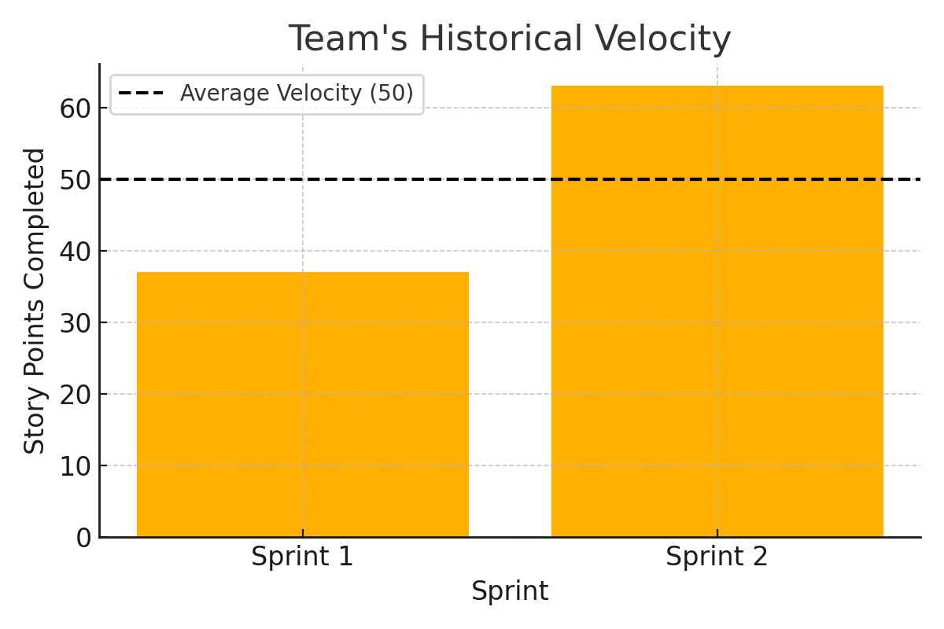
Team's Historical Velocity
Sprint 1 Velocity: 37 story points
Sprint 2 Velocity: 63 story points
Average Velocity: (37 + 63) / 2 = 50 story points

Slide 35
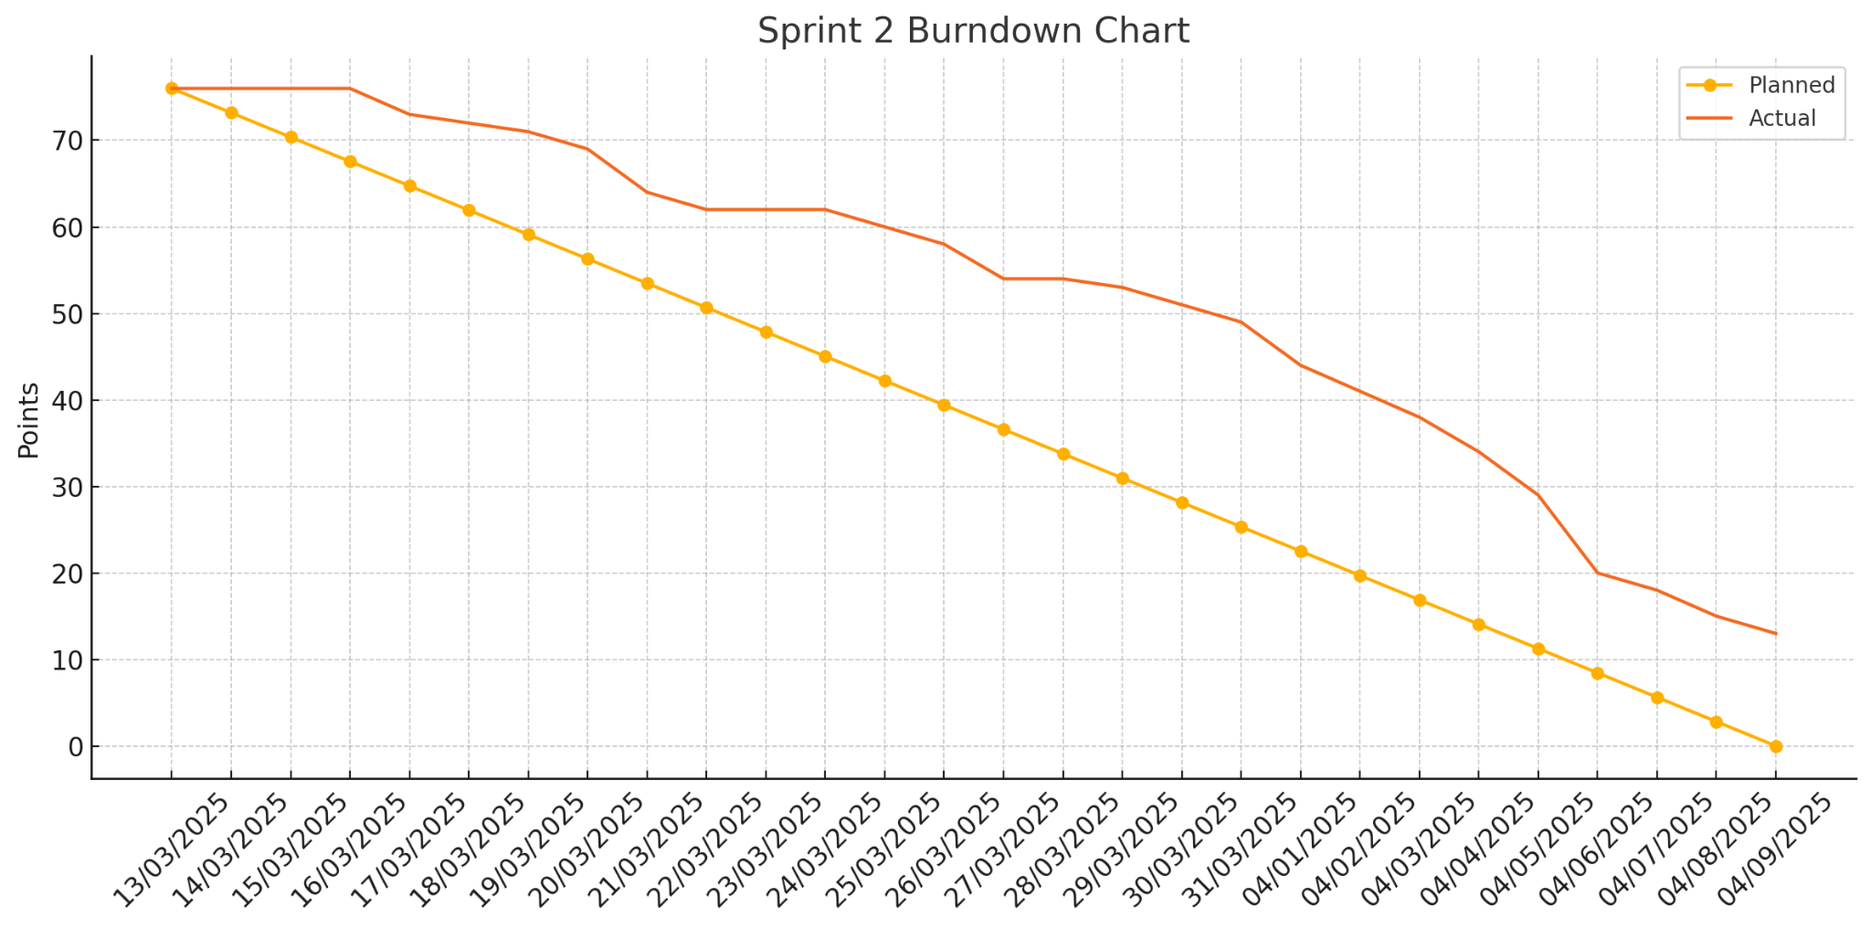
Burn Down Chart

Slide 36
Completed/Committed Ratio
74%
84.8%
78.42%
Sprint 2
Average Ratio
Sprint 1

Slide 37
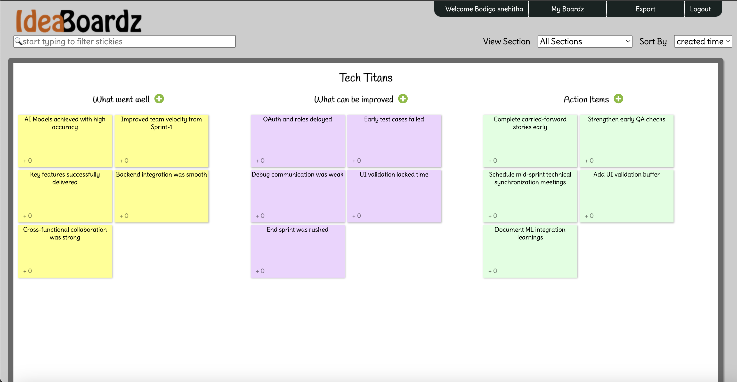
Retrospective

Slide 38
Sprint 3 Planning
ID | User Story | Acceptance Criteria | Story Points
US_09 | As a system user, I want to receive real-time alerts for detected threats so that I can take immediate action. | User receives notifications via email or app for detected threats. | 8
US_10 | As a user of the detection system, I want an option to report a false positive classification so that I can help improve detection accuracy. | Users can flag an incorrect detection for review. | 3
TS_09 | Develop a notification system for real-time alerts so that users are informed of potential threats. | Users receive accurate notifications for detected threats. | 8
TS_10 | Develop a feedback mechanism for false positive reports so that the system can improve over time. | Users can flag and submit incorrect classifications for review. | 3
US_04 (Carry forward) | As a platform administrator, I want to manage user roles and permissions so that I can control access levels. | System supports different access levels for users and admins. | 8
TS_03 (Carry forward) | Implement OAuth authentication for secure user access so that users can log in securely. | User authentication is secure, and access tokens work correctly. | 5

Slide 39
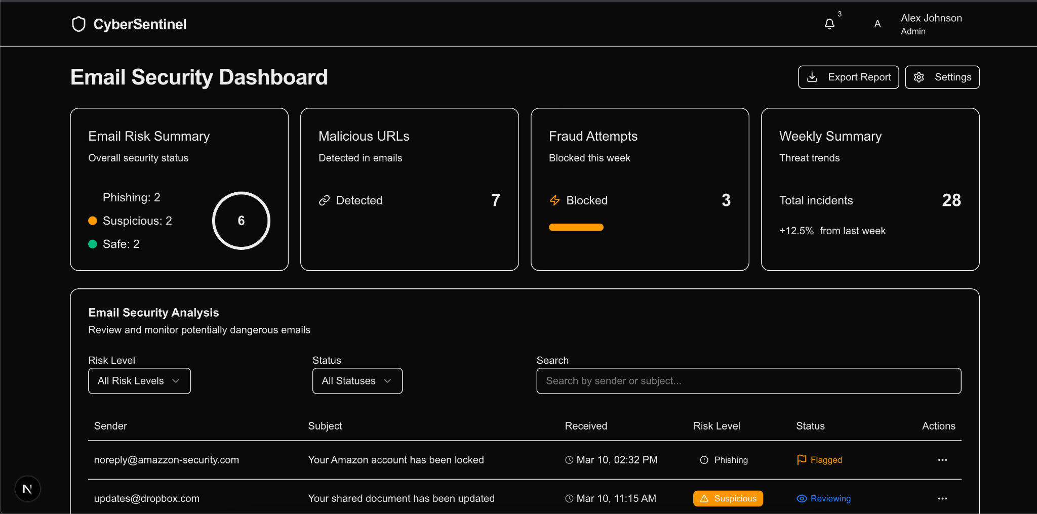
Application Screenshots

Slide 40
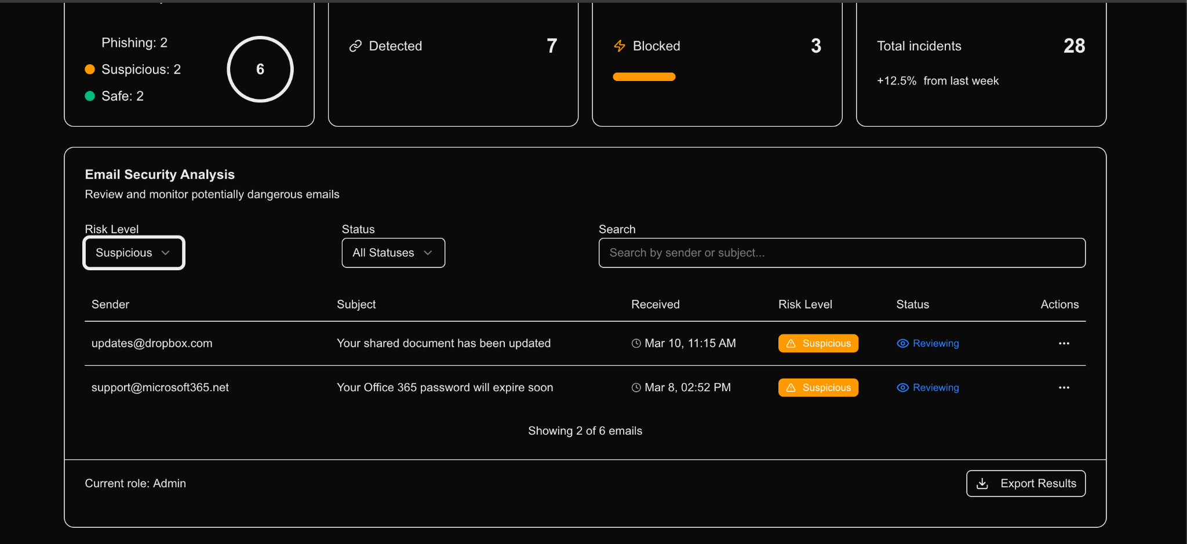
Application Screenshots

Slide 41
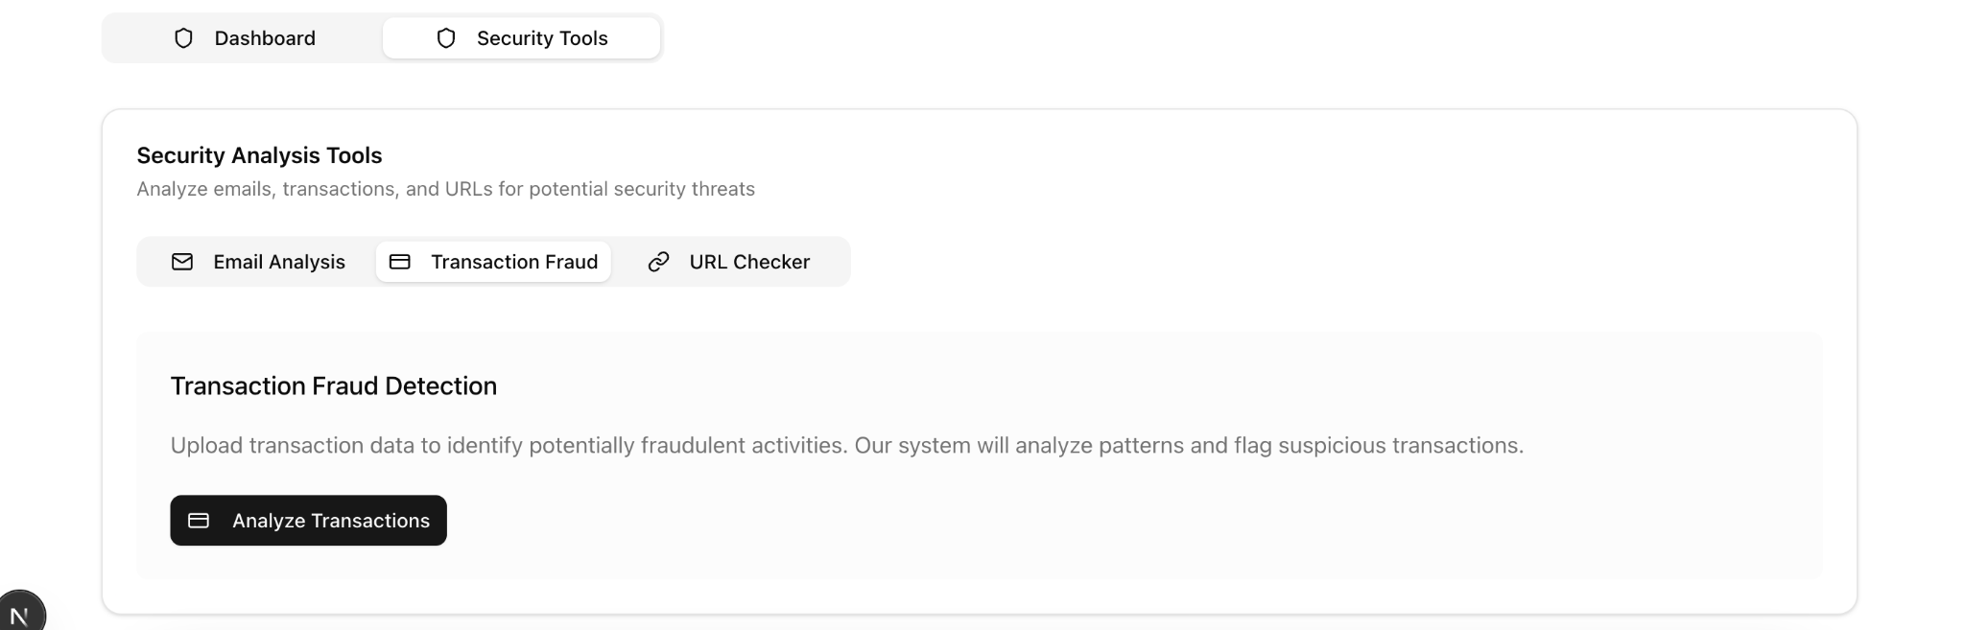
Application Screenshots

Slide 42
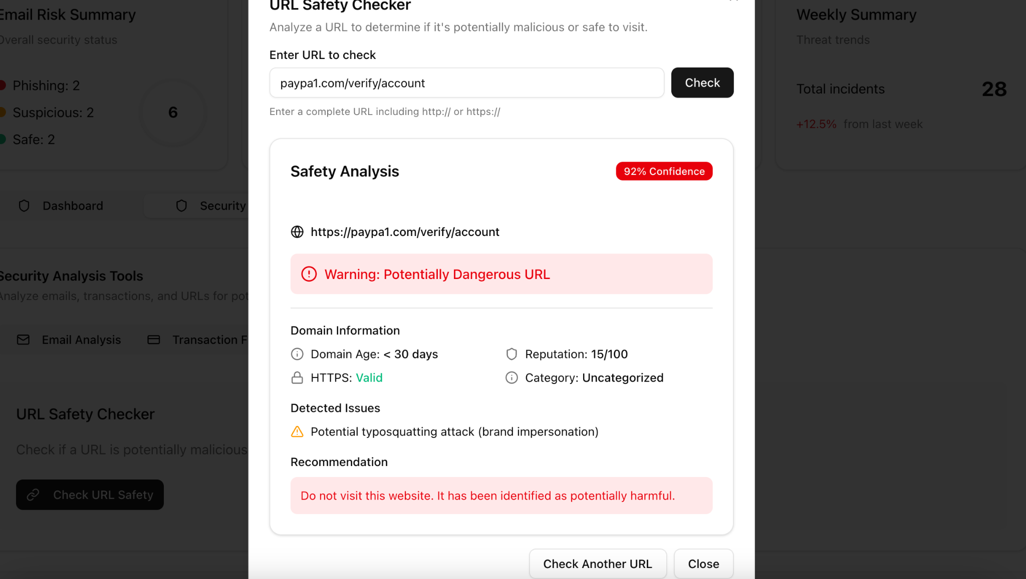
Application Screenshots

Slide 43
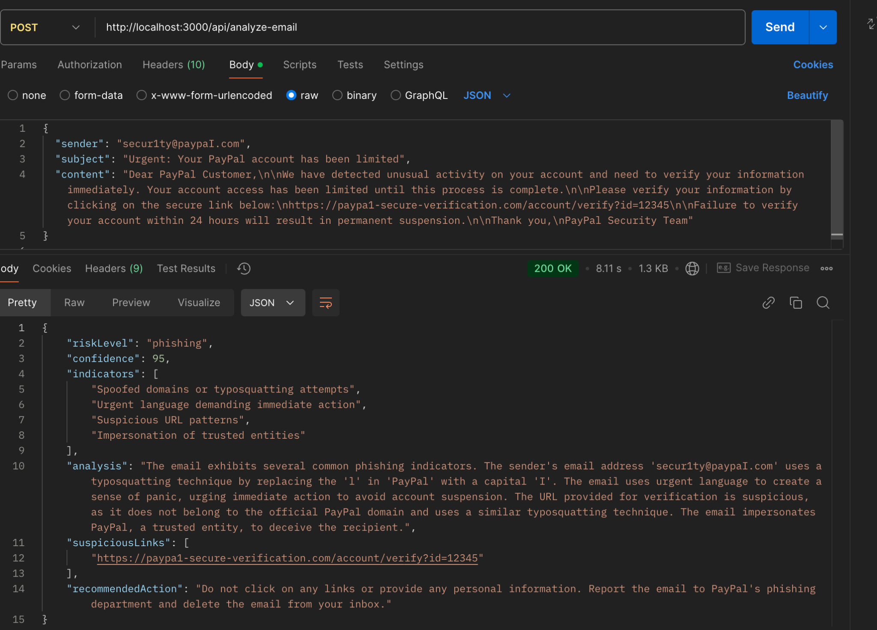
API Screenshots

Slide 44
Github Wikipage Link
https://github.com/htmw/2025S-Tech-Titans/wiki

Slide 45
Application Demo

Slide 46


